Slide 1


WELCOME
Welcome to the Presentation
Engineering Economics
Course Code: GED 221
MD Abdullah Al Noman
Lecturer , DBA, BAIUST
Bangladesh Army International University of Science and Technology

Slide 2
CONSTITUENTS OF THE PRESENTATION
Supply
Law of Supply
Factors affecting Supply
Supply function
Market Equilibrium
Numerical examples

Slide 3
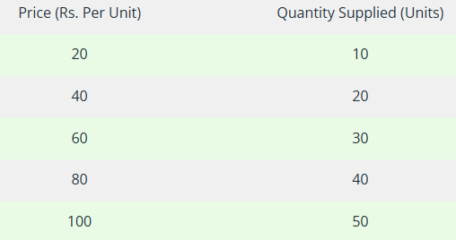
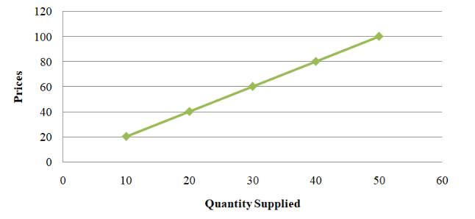
Supply
Supply refers to the quantity of a commodity that producers are willing and able to sell at a given price in a market during a specific time period.
The Law of Supply is a fundamental principle in economics that describes the relationship between the price of a good or service and the quantity that producers are willing to supply, assuming all other factors remain constant (ceteris paribus).
It states that, other things being equal, the quantity of a good supplied increases as the price of the good increases, and decreases as the price decreases. So this reflects a direct (positive) relationship between price and quantity supplied.

Slide 4
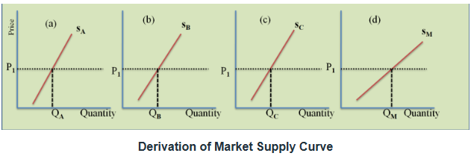
Supply
Individual supply: Individual supply refers to the quantity of a good or service that a single producer or seller is willing and able to offer for sale at different prices over a specific time period.
Market Supply: Market supply refers to the total quantity of a good or service that all producers in a market are willing and able to offer for sale at different prices over a specific time period.

Slide 5
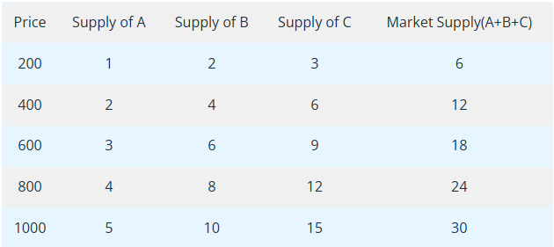
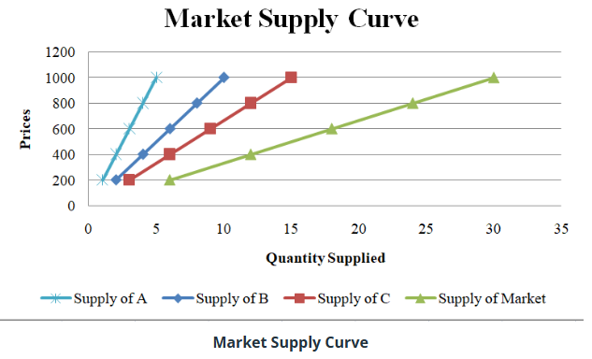
Supply

Slide 6
Factors affecting Supply
1. Price of the Good
The price of a good directly affects the quantity supplied.
Law of Supply: As the price of a good increases, the quantity supplied increases, and vice versa (ceteris paribus).
2. Costs of Production
The cost of inputs (e.g., labor, raw materials, machinery) directly impacts supply.
  Increase in Production Costs: Reduces profitability and decreases supply.
  Decrease in Production Costs: Enhances profitability and increases supply.
3. Technology
Advances in technology improve production efficiency, reducing costs and increasing supply.
  Example: Automation in manufacturing can lead to higher output at lower costs.
4. Prices of Related Goods
Substitutes in Production: If the price of a substitute good rises, producers may switch to producing that good, reducing the supply of the original good.
  Example: A farmer might switch from growing wheat to corn if corn prices rise.
Complentary Products: Goods produced together may have supply linked to one another.
  Example: An increase in beef production can also increase leather supply.

Slide 7
Factors affecting Supply
5. Government Policies
Taxes: Higher taxes on goods increase production costs and reduce supply.
Subsidies: Government financial support lowers production costs, encouraging higher supply.
Regulations: Strict regulations may increase production costs, reducing supply.
6. Expectations of Future Prices
If producers expect prices to rise in the future, they may reduce current supply to sell more later at higher prices.
Conversely, if they expect prices to fall, they may increase current supply.
7. Number of Producers
An increase in the number of producers in the market leads to higher overall supply.
Conversely, fewer producers result in a lower supply.

Slide 8
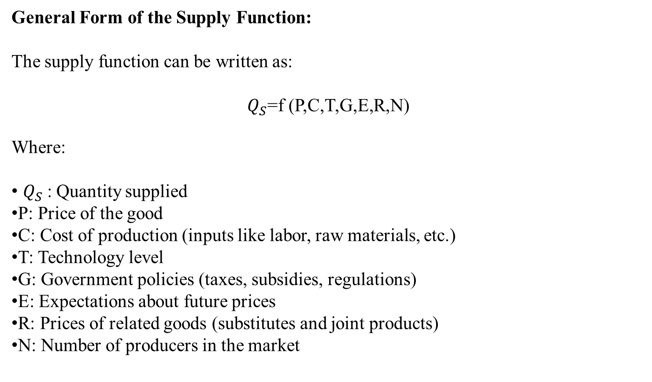
Supply function
The supply function in economics is a mathematical expression that represents the relationship between the quantity of a good or service supplied and the various factors affecting it.

Slide 9
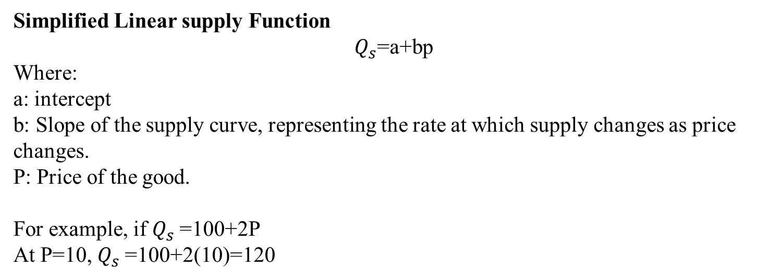
Supply function

Slide 10
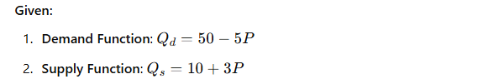
Supply function
Find out Equilibrium price and output.

Slide 11
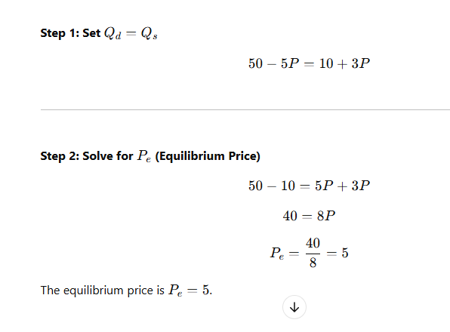
Supply function

Slide 12
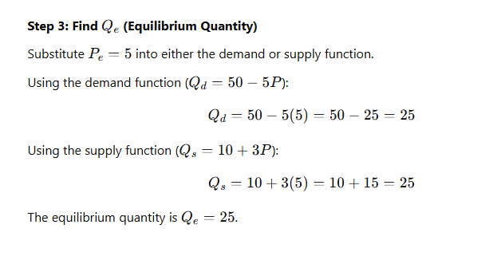
Supply function

Slide 13
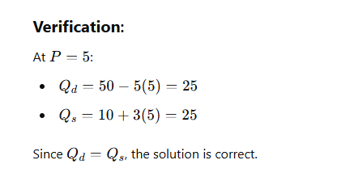
Supply function

